Slide 1

UNIVERSAL ACCESS TO ELECTRICITY

Slide 2
Outline
Chapter 1. Introduction to electrification
Chapter 2. Energy resources assessment using GIS
Chapter 3. Electrification analysis using GIS
Chapter 4. ONSSET – An Open-Source Spatial Electrification Tool
Chapter 5. The online electrification interface
Chapter 6. Hands-on experience with ONSSET
Notes:
We will start with a brief introduction to the universal access to energy challenge and how we can deal with it using GIS energy planning tools. Then we will show how we are using GIS to assess the availability of energy resources and how to carry out electrification planning. Later on, we will introduce ONSSET, the Open-Source Spatial Electrification Tool.
Right after, the online electrification interface based on ONSSET will be presented. The session will close with a hands-on exercise.

Slide 3
1. Introduction to electrification
Specific objective: review evidence underscoring the importance of access to electricity

Slide 4

Energy access today
About 2.7 billion people have no access to modern energy services.
Over 1.2 billion people do not have access to electricity.
The majority live mainly in rural areas of developing Asia and sub-Saharan Africa.
Nighttime light data provided by the National Centers for Environmental Information.
Notes:
Energy holds a privileged place in durable and resilient human societies. It is a vital commodity highly interconnected with socioeconomic development and well-being. Despite that, in 2016, around 2.7 billion people did not have access to modern energy services, and almost 1.2 billion people did not have access to electricity.
The vast majority of these people are located in rural areas in sub-Saharan Africa, developing Asia, and some parts of Central and South America. These people rely exclusively on traditional fuels to cover their daily energy needs, which in many cases causes harmful effects to themselves and their environment. This calls for a shift towards sustainable forms of energy. This tool focuses on the most convenient form of energy, electricity, and aims to address the SDG 7.
Note that between 1990 and 2010, the number of people globally with access to electricity increased by 1.7 billion (United Nations Development Programme, 2016) without a definite target of universal electrification.

Slide 5
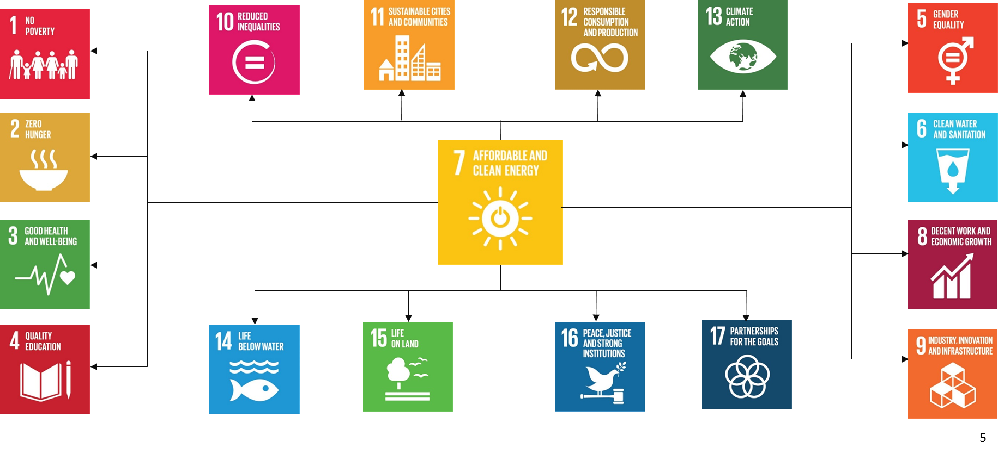












Universal access to electricity
Without access to electricity
With access to electricity
Link to SDGs
Access to modern energy is beneficial for:
Health services
Education
Daily activities (lighting, heating, cooking, transportation)
Gender equality
Indoor environment
Business, agricultural, infrastructure and telecommunications sectors
Notes:
Early electrification is a key enabler for socioeconomic development. Studies point out that the very first kilowatt-hours provided are beneficial to human development. The level and quality of health services; education; gender equality; indoor environment; daily activities like lighting, heating, cooking and transportation; as well as the business, agricultural, infrastructure and telecommunications sectors can all be upgraded with access to modern energy services.
To achieve this goal, proper energy planning should be carried out.
Note: (SDG) 7 focuses on a concerted global effort to ensure access to affordable, reliable, sustainable and modern energy for all. Energy is interconnected with all of the other SDGs.

Slide 6
Importance of energy planning
Energy planning is essential for matching demand and supply.
System cost minimization, without compromising energy security, the reliability of supplies and environmental integrity, is a primary planning objective.
Fundamental energy system transformation is key to SDG 7.
However…
Past energy planning paradigms (models and mindsets) are largely inadequate for access analysis and planning.
Effective electrification planning requires geospatial information (e.g., settlement location, distances from the grid and road infrastructure, energy resource availability).
In developing countries, there is a lack of reliable energy-related data.
Notes:
Energy system planning is essential to match supply with growing demand; it is necessary to achieve this in the most cost-effective way. In addition, moving from planned, centralized and expensive energy carriers, towards fluctuating, decentralized and cost-effective renewable energy production necessitates considerable modifications in the energy infrastructure, which should be appropriately planned in order to have effective results.
These modifications are primarily motivated by geospatial questions. Therefore, ground level geospatial data are of key importance to help identify the most effective electrification strategy. Unfortunately, in developing countries, energy-related data at this level are usually scarce. This is where GIS can be an asset.

Slide 7
GIS and energy system models
Conventional long-term energy models such as OSeMOSYS, TIMES, MESSAGE, etc. fail to take into account the spatio-temporal fluctuations of energy resources and the demand side.
To illustrate, the wind speed varies in time and space, and so does the potential wind energy yield. The same applies to other energy sources with a stochastic nature.
Also, the power infrastructure differs from one area to another and so does the demand.
Without GIS models, details essential for energy planning cannot be captured.
Notes:
There are several parameters that feed energy system models that comprise geospatial attributes. Conventional energy system models fail to take into account spatial fluctuations.
For example, the wind speed varies in time and space and so does the potential wind energy yield. The same applies to other intermittent energy resources.
Also, the power infrastructure differs from one location to another and so does the demand.
We have to look for more integrated solutions in order to incorporate these dynamics into energy system models and enable more sustainable energy infrastructure planning while considering a growing mix of energy technologies.

Slide 8
Why geographic information systems?
GIS serves multiple purposes:
Location-based assessments: GIS tools enable assessments to analyse energy-related geospatial information.
Remote sensing: GIS tools facilitate the integration of remote sensing techniques to derive resource availability and energy potentials in cases where such data are not (publicly) available.
Illustration of results: GIS can illustrate results in interactive maps, providing an effective science and policy interface.
Notes:
Let’s see now how the integration of GIS in energy planning can be beneficial.
GIS-based data can analyse demand at the location where it is actually happening and make location-based projections considering specific characteristics (for example, urban and rural areas) and their corresponding energy access targets.
Furthermore, GIS utilizes remote sensing satellite data in order to derive resource availability and energy potentials at local levels in areas where such data are not available.
Last but not least, GIS can be used to illustrate results in interactive maps. These illustrations can provide an effective science and policy interface by communicating key indicators for electrification planning “at-a-glance”, ensuring that findings can easily be absorbed by policymakers.
The integration of GIS in energy system models, however, is still in its infancy.

Slide 9
2. Energy resources assessment using GIS
Specific objective: understand GIS as a tool to assess energy resources
Notes:
Let us start with a short description of how GIS can support energy planners in assessing resources availability and energy potentials for a certain region.

Slide 10
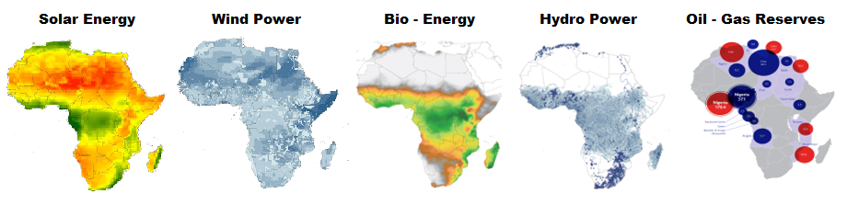
Geospatial resources assessment
The quandary…
What is the energy resource situation at each location?
Which technologies are best suited to tap into these resources?
What are the costs of electricity generation by technology and resource input?
Notes:
We will examine the African continent.
The fundamental questions an energy planner has to answer are:
What is the energy resource situation at each location?
Which technologies are best suited to tap into these resources?
What are the costs of electricity generation by technology and resource input?
We can see how GIS helps answer these questions by identifying and quantifying available resources and energy potentials by location.

Slide 11
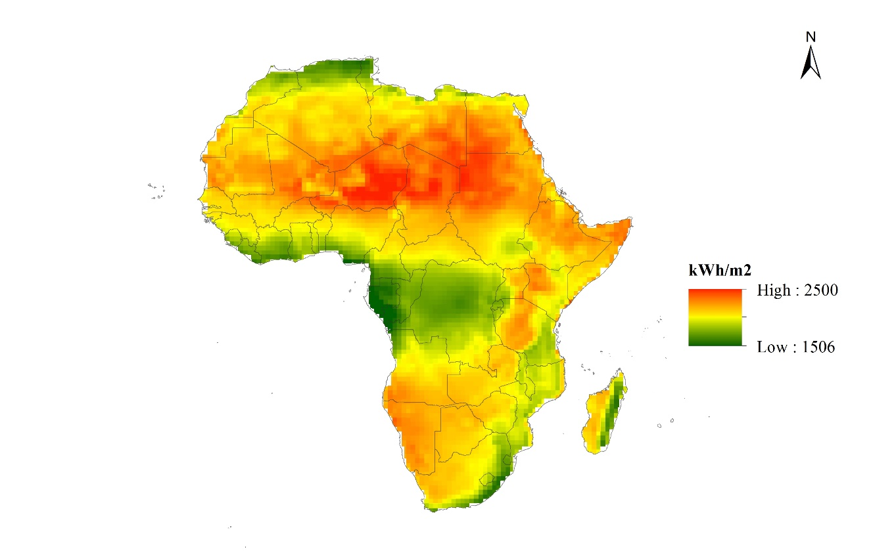
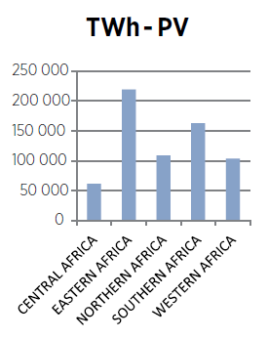
Spatial solar availability
Table 1. Summary of CSP and PV potentials in different African subregions
Global horizontal irradiation map of Africa
 | CSP | PV
 | TWh | TWh
CENTRAL AFRICA | 29 909 | 61 643
EASTERN AFRICA | 175 777 | 219 481
NORTHERN AFRICA | 93 544 | 109 033
SOUTHERN AFRICA | 149 610 | 162 817
WESTERN AFRICA | 22 747 | 103 754
TOTAL | 471 587 | 656 728
Area with high potential for PV system deployment
Layer’s specifications
Spatial resolution: 1 degree (~110.5 km)
Historical time series: 22 years
Source: Langley Atmospheric Science Research Center
Notes:
We start with solar availability. The layer was developed based on global horizontal irradiation (kWh/m²/day) data obtained from the Atmospheric Science Data Center at the NASA Langley Research Center. In particular, the data provided 22 years, from July 1983 to June 2005, of monthly and annual average radiation values, with spatial resolution of 1x1 degree and global spatial coverage. The data were inserted into ArcGIS and processed in order to obtain the radiation on an annual basis (kWh/m²/year) in the desired raster format.
Raster data is made up of pixels (also referred to as grid cells). They are usually regularly spaced and square, but they don’t have to be. Rasters often look pixelated because each pixel is associated with a value or class.
Draw on the board if available the difference between vectors and rasters.
Excluding the Sahara region (desert), the results show high potential for PV systems deployment in Eastern and Southern Africa as presented in the graph.
Details:
The data were interpolated using the two-dimensional minimum curvature regularized spline technique, resulting in a smooth raster surface passing exactly through the input points. Using raster calculation techniques, the raster was further processed in order to yield and illustrate radiation on an annual basis (kWh/m²/year). The final step included resampling of the existing layer in order to obtain the desired resolution of 0.083 degrees (approximately 10 kilometres in the equator), which was used in this analysis.

Slide 12
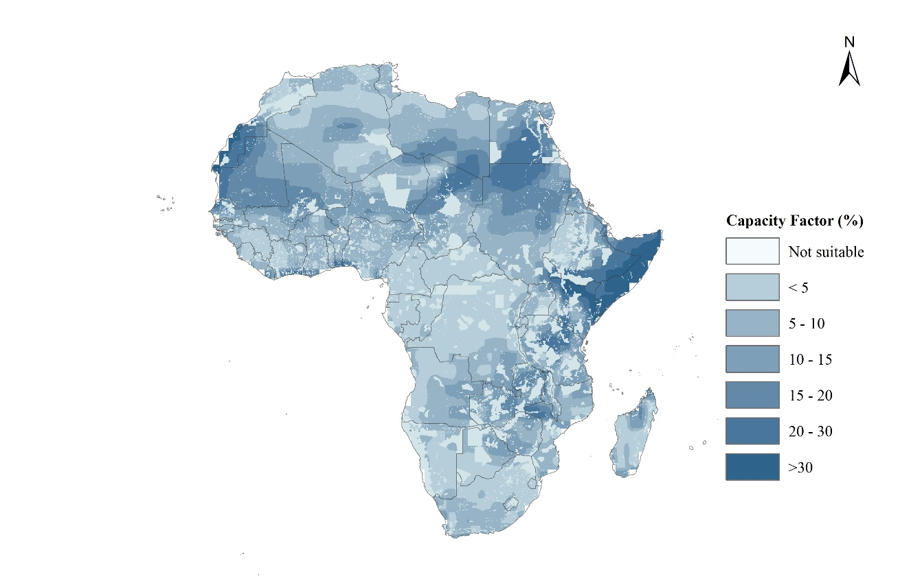
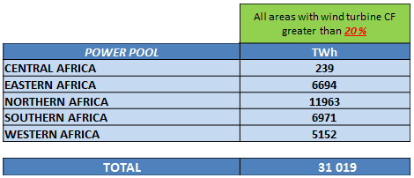
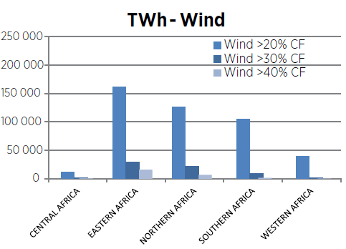
Spatial wind availability
Wind power capacity factor map of Africa
Table 2. Summary of wind power potential in different African subregions
Areas with high potential for wind power project deployment
Layer’s specifications
Spatial resolution: 0.5 degrees
Historical time series: 20 years
Source: NASA - GES DISC
Notes:
Moving on to wind availability: Initially, 20 years of raw GIS data on average wind speed at a height of 10 metres with a spatial resolution of 0.5ºx0.5º (approximately 55 km²) were acquired from NASA for 1995 to 2014. The wind speed changes with altitude because of frictional effects at the surface of the earth. Since the wind speed data are given at 10 metres, a proper extrapolation should be applied in order to obtain a wind speed reading at the hub height (55 metres) of the chosen wind turbine (Vestas-44, having 600kW of rated power).
To estimate the wind energy potential in each grid cell, it is necessary to obtain the wind speed probability distribution. It provides the repetition frequency of a specific wind speed reading (1 to 25 m/s) at a given site. The power produced by a wind turbine is estimated by combining the probability distribution and the manufacturer’s power curve of the selected wind turbine. The yearly expected wind energy yield of each grid cell was estimated after considering the availability factor of a wind turbine as well as electrical and mechanical losses, and several criteria regarding the localization of wind farms, such as protected areas, water bodies and others.
The next step is the calculation and the visualization of the capacity factor. The capacity factor reflects the potential wind power at a given site and can be used for comparing different sites before the installation of wind power plants. The capacity factor of a wind turbine is defined as the ratio of the yearly expected wind energy production to the energy production if the wind turbine were to operate at its rated power throughout the year.
The results show high wind power potential in eastern and north-western parts of Africa.

Slide 13
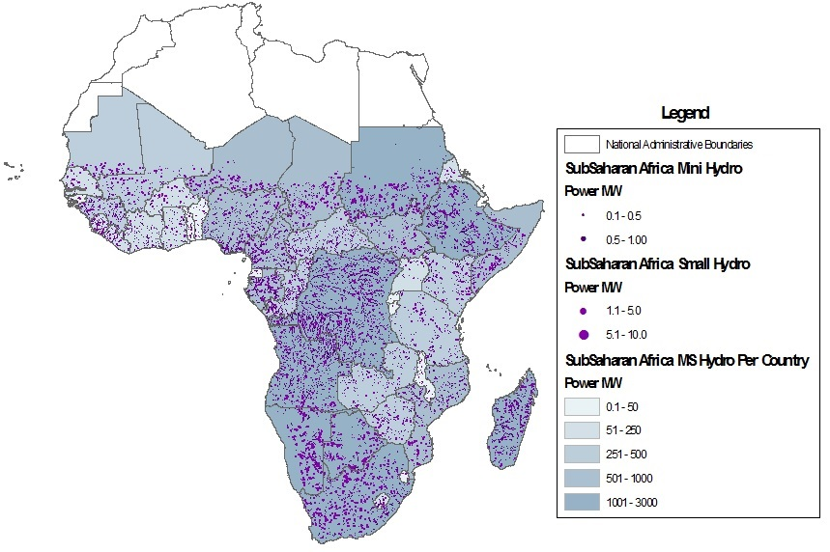
Spatial mini/small hydropower availability
Table 3. Summary of mini/small hydropower potential in different African subregions
Hydropower potential map of Africa
 | MW
CENTRAL AFRICA | 5,721
EASTERN AFRICA | 5,699
SOUTHERN AFRICA | 9,917
WESTERN AFRICA | 3,884
TOTAL | 25,221
Sources:
USGS/NASA SRTM
CGIAR-CSI
EU JRC
WWF
Notes:
Africa is rich in hydro resources, with a significant portion of the current electricity generation (16 per cent) coming from hydropower. An estimated 90 per cent of the potential remains untapped, however. GIS can help identify sites with hydropower potential using a number of datasets.
We start with the global runoff raster layer (available at 0.125 degrees), combine it with a flow accumulation raster (derived from digital elevation maps) and acquire an estimation of discharge (volume flow) for each cell. Then we connect the river streams to get an adequate number of sample points, and by using elevation diferences, get an indication of potential hydropower in these sample points.
The map spatially presents the identified potential sites for mini- and small hydropower deployment in sub-Saharan Africa. Approximately 10,000 sites were identified, with the southern part of the continent showing the highest potential.

Slide 14
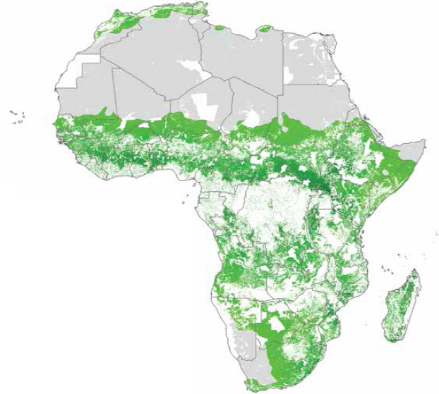
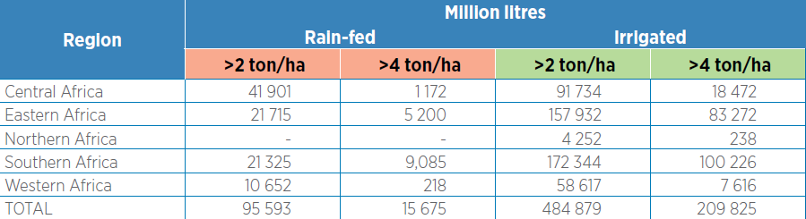
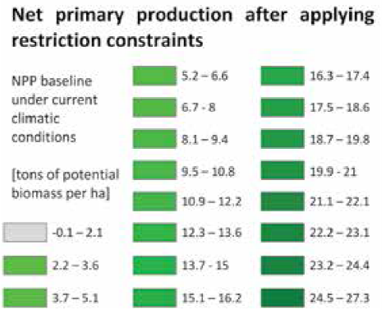
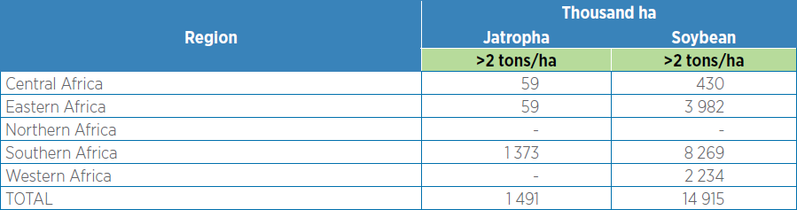
Spatial bioenergy availability
Table 4. Summary of sugarcane-based bioethanol production in different African subregions
Table 5. Summary of land areas for Jatropha and soybean crops with yields over 2 tons per hectare
Source: IIASA, Global Agro-ecological Zoning
Notes:
Bioenergy data have been extracted from an open data platform developed by the International Institute for Applied Systems Analysis, Global Agro-ecological Zoning. This is a vast database of downloadable land data in GIS format.
Here we show a couple of examples.
The first one shows a summary of the potential production of sugarcane-based bioethanol under two different schemes; rainfed and irrigated.
For the assessment of Jatropha and soybean potential, the size of land areas with yields greater than certain values was assessed. Potential yields were assessed, but they were not converted into fuel equivalent, due to high uncertainties and lack of information on further conversion processes.

Slide 15
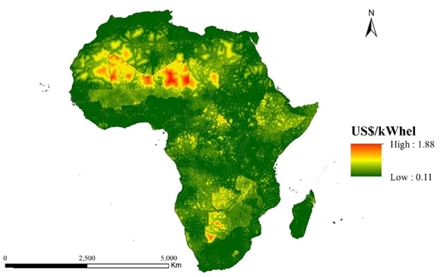
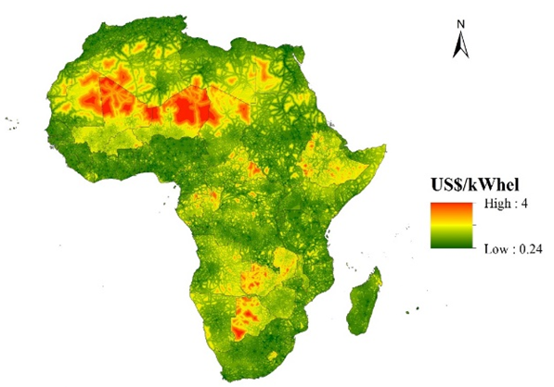
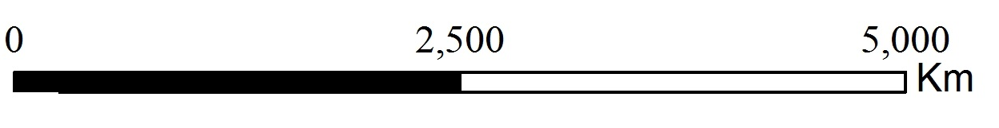
Spatial diesel LCOE
LCOE for diesel generators (current fuel price)
LCOE for diesel generators (projected fuel price)
Current diesel price*
Coastal countries | Land-locked countries
0.34 $/l | 0.34-0.36 $/l
Projected diesel price**
Coastal countries | Land-locked countries
0.82 $/l | 0.82-0.85 $/l
<
* According to the current crude oil price of $47 per barrel.
** According to the projected crude oil price of $113 per barrel.
Notes:
The suitability of diesel generators is basically represented by the levelized cost of energy (LCOE) they can achieve. In order to estimate this cost, a number of factors are taken into consideration. Initially, using global coastlines and administrative boundaries layers in GIS, we characterize the countries as landlocked or coastal. Landlocked countries tend to have higher fuel costs. Then, the travel time to major cities (of at least 50,000 people) was considered and combined with the international diesel price, which yielded a current and a projected map of LCOE for diesel generators.

